Slide 1

Artificial Intelligence
Search

Slide 2
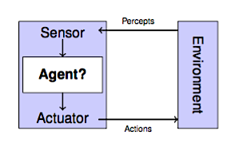
Frame for AI
An agent percieves its environment with sensors and acts on
environment using actuators.
Car: Sensors: camera, lidar, speed gauge, .. Actuators: gas petal, , steering wheel, brake petal, ...
Website, Program, ...
Input/Output: Outputs affect environment, which affects input , which outputs, . . .

Slide 3
Agent Design
The environment largely determines the agent design.
Fully/partialy observable agent → request memory (internal state)
Discrete/ continuous → agent can/can’t enumerate all states Stochastic/deterministic → agent deals with contingencies
Single-agent/multi-agent → agent may need to behave randomly.
Notes:
Пристапност / непристапност
Одреденост / случајност
Повременост / доследност
Статичност / динамичност
Дискретност / непрекинатост
Едноагентна / повеќеагентна

Slide 4
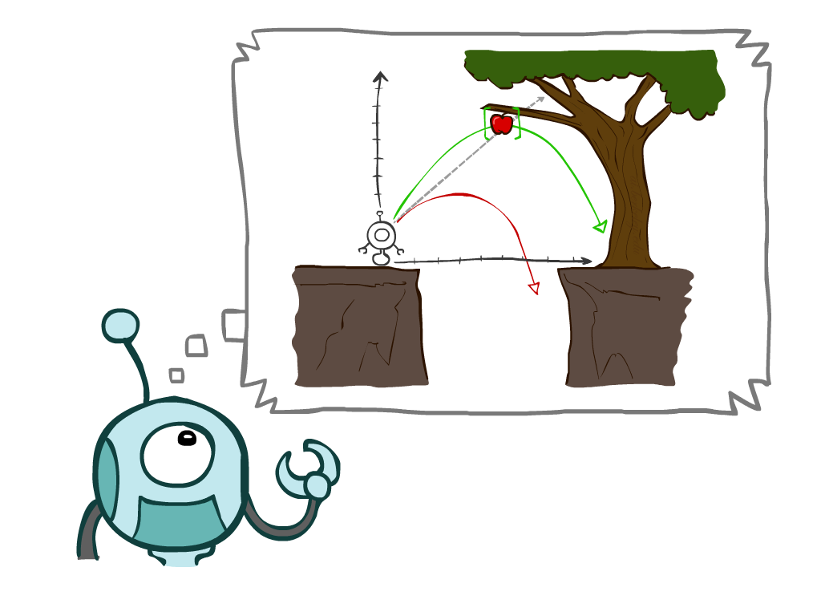
Today
Agents that Plan Ahead
Search Problems
Uninformed Search Methods
Depth-First Search
Breadth-First Search
Uniform-Cost Search
Notes:
General theme in the class:
A goal we have in mind.
A mathematical abstraction to formalize this
Algorithms that operate on these abstractions
По прва широчина (прво по широчина)
По прва длабочина (прво по длабочина)
По изедначена цена
Со ограничена длабочина
Со итеративно одење во длабочина

Slide 5
Agents that Plan

Slide 6
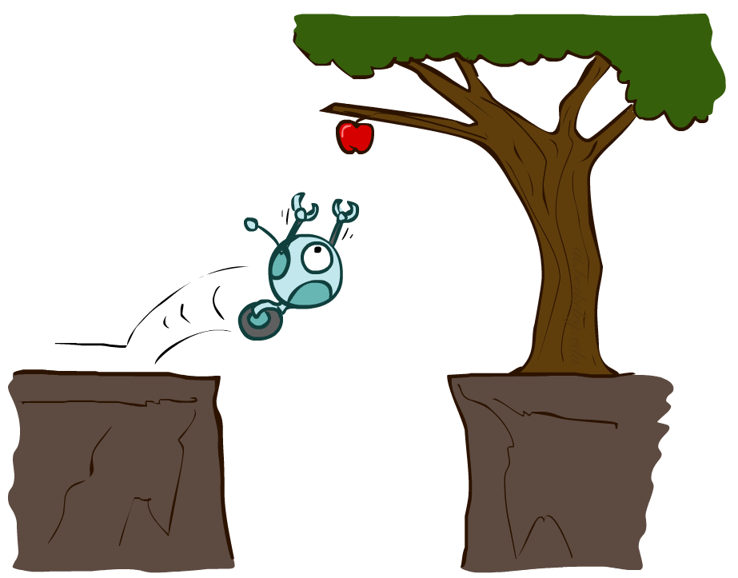
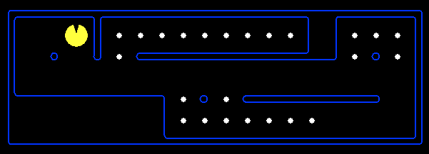
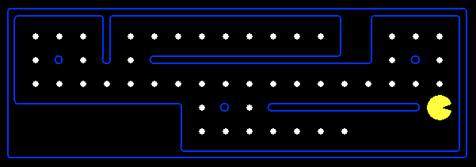
Reflex Agents
Reflex agents:
Choose action based on current percept (and maybe memory)
May have memory or a model of the world’s current state
Do not consider the future consequences of their actions
Consider how the world IS
Can a reflex agent be rational?
[Demo: reflex optimal (L2D1)]
[Demo: reflex optimal (L2D2)]
Notes:
Examples: blinking your eye (not using your entire thinking capabilities), vacuum cleaner moving towards nearest dirt

Slide 7
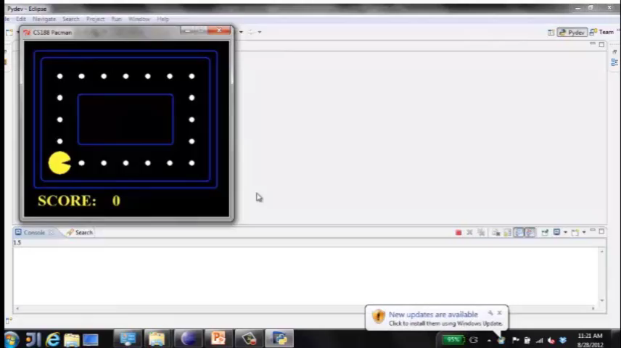
Video of Demo Reflex Optimal

Slide 8
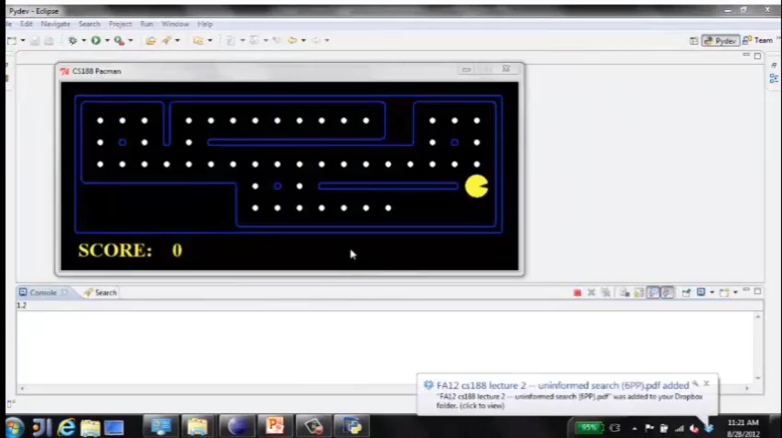
Video of Demo Reflex Odd
Notes:
Ne e optimalen

Slide 9
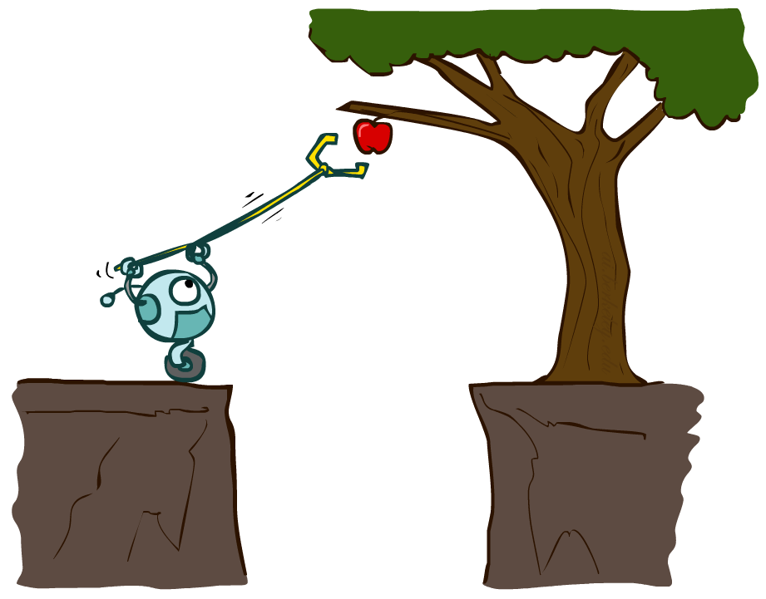
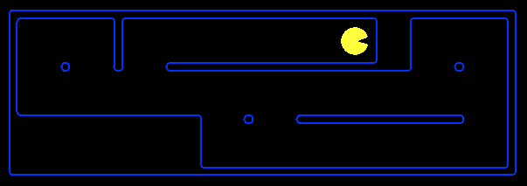
Planning Agents (Goal-oriented Agents)
Planning agents:
Ask “what if”
Decisions based on (hypothesized) consequences of actions
Must have a model of how the world evolves in response to actions
Must formulate a goal (test)
Consider how the world WOULD BE
Optimal vs. complete planning
Planning vs. replanning
Notes:
Комплетност, т.е. дали секогаш го наоѓа решението доколку тоа постои
Оптималност: дали секогаш го наоѓа решението со најниска цена

Slide 10
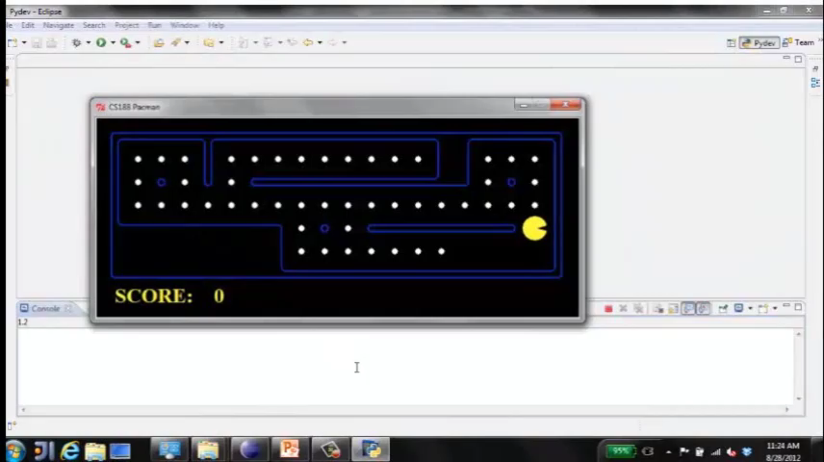
Video of Demo Replanning
Notes:
Kade e najbliskata tocka, izedi ja I promisli nov plan sto da pravi

Slide 11
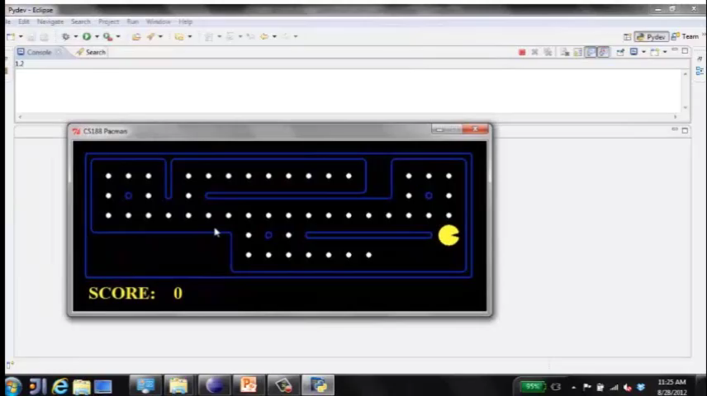
Video of Demo Mastermind
Notes:
Mnogu sekvenci na akcii da se zemat predvid
Nekogas ne sakas mnogu da cekas da najde najdobro

Slide 12
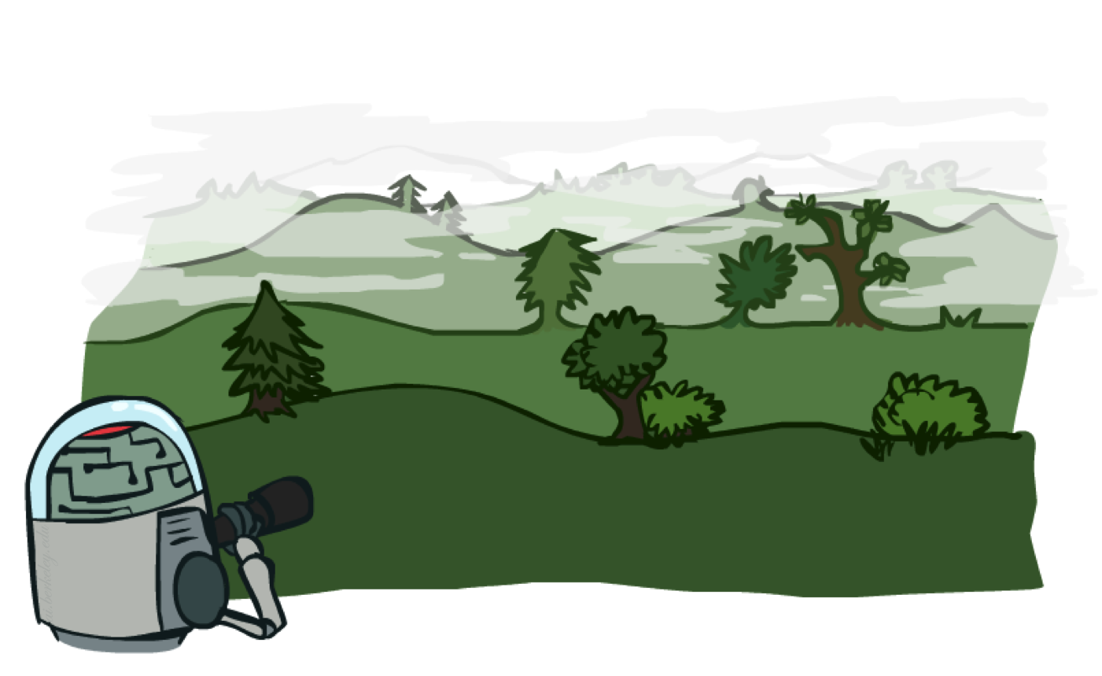
Search Problems

Slide 13

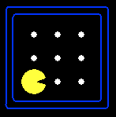





Search Problems
A search problem consists of:
A state space
A successor function
(with actions, costs)
A start state and a goal test
A solution is a sequence of actions (a plan) which transforms the start state to a goal state
“N”, 1.0
“E”, 1.0
Notes:
Sostojba – kade e macman kade se tockite
Kade moze da se dvizi, sto da napravi – koj e problmeot, kako se odvidva kakov e svetot, model na nasiot problem
Resenie – od poectna sostojba da odjdeme do krajna cel
Often comes back on exams
Goal test – sometimes more than one state that satisfies having achieved the goal, for example, “eat all the dots”
Abstraction

Slide 14

Search Problems Are Models

Slide 15
Example: Traveling in Romania
State space:
Cities
Successor function:
Roads: Go to adjacent city with cost = distance
Start state:
Arad
Goal test:
Is state == Bucharest?
Solution?

Slide 16
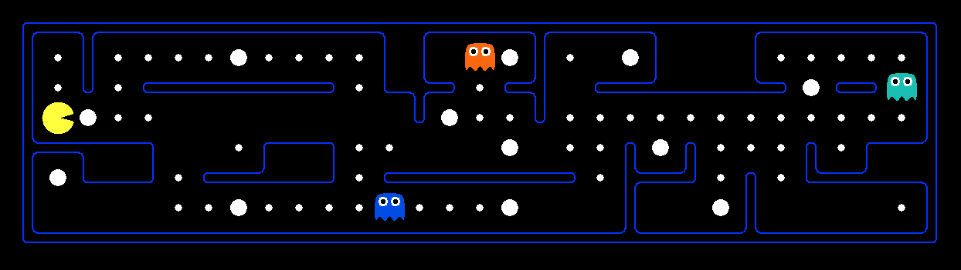
What’s in a State Space?
The world state includes every last detail of the environment
A search state keeps only the details needed for planning (abstraction)
Problem: Pathing
States: (x,y) location
Actions: NSEW
Successor: update location only
Goal test: is (x,y)=END
Problem: Eat-All-Dots
States: {(x,y), dot booleans}
Actions: NSEW
Successor: update location and possibly a dot boolean
Goal test: dots all false
Notes:
Wrong example for “eat-all-dots”: (x, y, dot count)

Slide 17
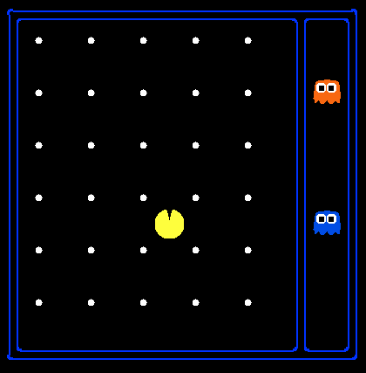
State Space Sizes?
World state:
Agent positions: 120
Food count: 30
Ghost positions: 12
Agent facing: NSEW
How many
World states?
120x(2³⁰)x(12²)x4
States for pathing?
120
States for eat-all-dots?
120x(2³⁰)
Notes:
90 * (2^30-1) + 30 * 2^29 = 145 billion
2^29 = 536 870 912

Slide 18
Quiz: Safe Passage
Problem: eat all dots while keeping the ghosts perma-scared
What does the state space have to specify?
(agent position, dot booleans, power pellet booleans, remaining scared time)

Slide 19
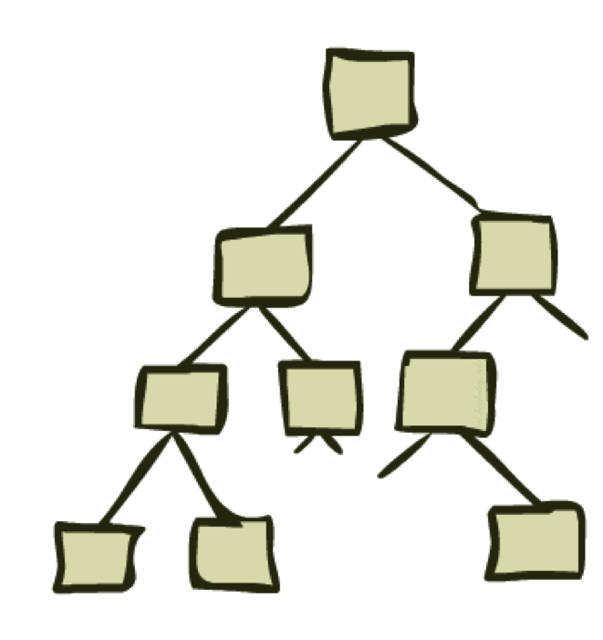
State Space Graphs and Search Trees

Slide 20
State Space Graphs
State space graph: A mathematical representation of a search problem
Nodes are (abstracted) world configurations
Arcs represent successors (action results)
The goal test is a set of goal nodes (maybe only one)
In a state space graph, each state occurs only once!
We can rarely build this full graph in memory (it’s too big), but it’s a useful idea

Slide 21
State Space Graphs
State space graph: A mathematical representation of a search problem
Nodes are (abstracted) world configurations
Arcs represent successors (action results)
The goal test is a set of goal nodes (maybe only one)
In a search graph, each state occurs only once!
We can rarely build this full graph in memory (it’s too big), but it’s a useful idea
a
G
b
c
e
d
f
S
h
p
q
r
Tiny search graph for a tiny search problem

Slide 22
Search Trees
This is now / start
“N”, 1.0
“E”, 1.0
Possible futures
A search tree:
A “what if” tree of plans and their outcomes
The start state is the root node
Children correspond to successors
Nodes show states, but correspond to PLANS that achieve those states
For most problems, we can never actually build the whole tree
Notes:
Different plans that achieve the same state, will be different nodes in the tree.

Slide 23
State Space Graphs vs. Search Trees
State Space Graph
Each NODE in in the search tree is an entire PATH in the state space graph.
Search Tree
S
a
G
d
e
p
b
c
q
b
c
e
h
r
d
e
f
a
a
h
r
p
q
f
S
h
We construct both on demand – and we construct as little as possible.
p
q
f
q
c
G
p
q
r
q
c
G
a
a

Slide 24

Quiz: State Space Graphs vs. Search Trees
Consider this 4-state graph:
How big is its search tree (from S)?
a
S
G
b
Important: Lots of repeated structure in the search tree!

Slide 25
Tree Search
Notes:
Da se izgradi strebloto postepeno (inkrementalno) tolku kolku sto ni e potrebno da ja najdeme celta/resenieto

Slide 26
Search Example: Romania

Slide 27
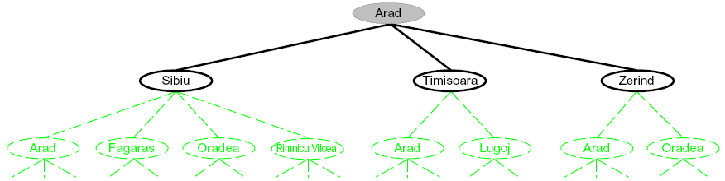
Searching with a Search Tree
Search:
Expand out potential plans (tree nodes)
Maintain a fringe of partial plans under consideration
Try to expand as few tree nodes as possible
Notes:
Celta ni e sto pomalku od stebloto da go arzlozime

Slide 28
General Tree Search
Important ideas:
Fringe
Expansion
Exploration strategy
Main question: which fringe nodes to explore?
Notes:
Prvo samo inicijlaniot jazol
Kandidatyi za razlouvanje se listovite/naslednicite odsostojbata onamu kade sto si
Fringe – lista od jazli koi cekaat/treba da se razlozat

Slide 29
Example: Tree Search
a
G
b
c
d
e
f
S
h
p
q
r
Notes:
Left: show tree
Right: fringe

Slide 30
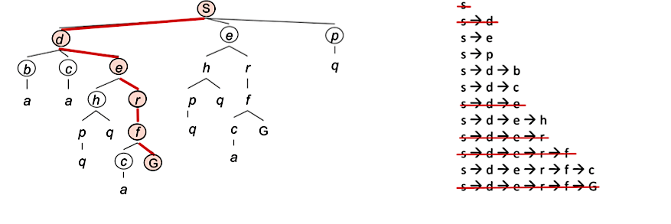
Example: Tree Search
a
G
b
c
d
e
f
S
h
p
q
r
Notes:
Left: show tree
Right: fringe

Slide 31
State Space Graphs vs. Search Trees
State Space Graph
Each NODE in in the search tree is an entire PATH in the state space graph.
Search Tree
S
a
G
d
e
p
b
c
q
b
c
e
h
r
d
e
f
a
a
h
r
p
q
f
S
h
We construct both on demand – and we construct as little as possible.
p
q
f
q
c
G
p
q
r
q
c
G
a
a

Slide 32

Depth-First Search

Slide 33
Depth-First Search
Strategy: expand a deepest node first
Implementation: Fringe is a LIFO stack
a
G
a
c
b
c
b
e
d
e
d
f
f
S
h
h
p
p
r
q
r
q
S
d
e
p
b
c
e
h
r
q
a
a
h
r
p
q
f
p
q
f
q
c
G
q
c
G
a
a

Slide 34
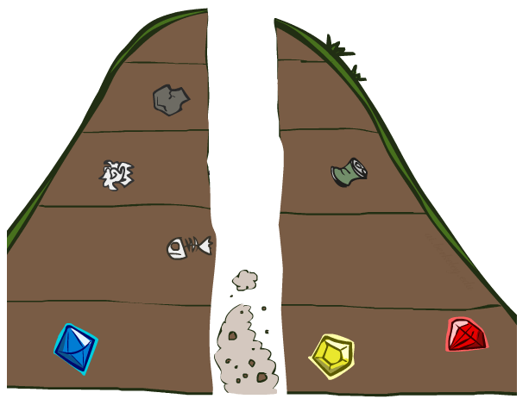
Search Algorithm Properties

Slide 35
Search Algorithm Properties
Complete: Guaranteed to find a solution if one exists?
Optimal: Guaranteed to find the least cost path?
Time complexity?
Space complexity?
Cartoon of search tree:
b is the branching factor
m is the maximum depth
solutions at various depths
Number of nodes in entire tree?
1 + b + b² + …. b^{m} = O(b^{m})
1 node
b
…
b nodes
b² nodes
m tiers
b^{m} nodes
Notes:
Комплетност, т.е. дали секогаш го наоѓа решението доколку тоа постои
Временска комплексност: број на јазлите кои се генерираат при пребарувањето
Просторна комплексност: најголем број јазли во меморијата
Оптималност: дали секогаш го наоѓа решението со најниска цена

Slide 36
Depth-First Search (DFS) Properties
What nodes DFS expand?
Some left prefix of the tree.
Could process the whole tree!
If m is finite, takes time O(b^{m})
How much space does the fringe take?
Only has siblings on path to root, so O(bm)
Is it complete?
m could be infinite, so only if we prevent cycles (more later)
Is it optimal?
No, it finds the “leftmost” solution, regardless of depth or cost
1 node
b
…
b nodes
b² nodes
m tiers
b^{m} nodes
Notes:
Алгоритмот не е комплетен, доколку во просторот има јамки
Временска комплексност: O(b^{m})
Просторна комплексност: O(bm)
Ако лаците имаат цена, тогаш не го наоѓа оптималниот пат

Slide 37
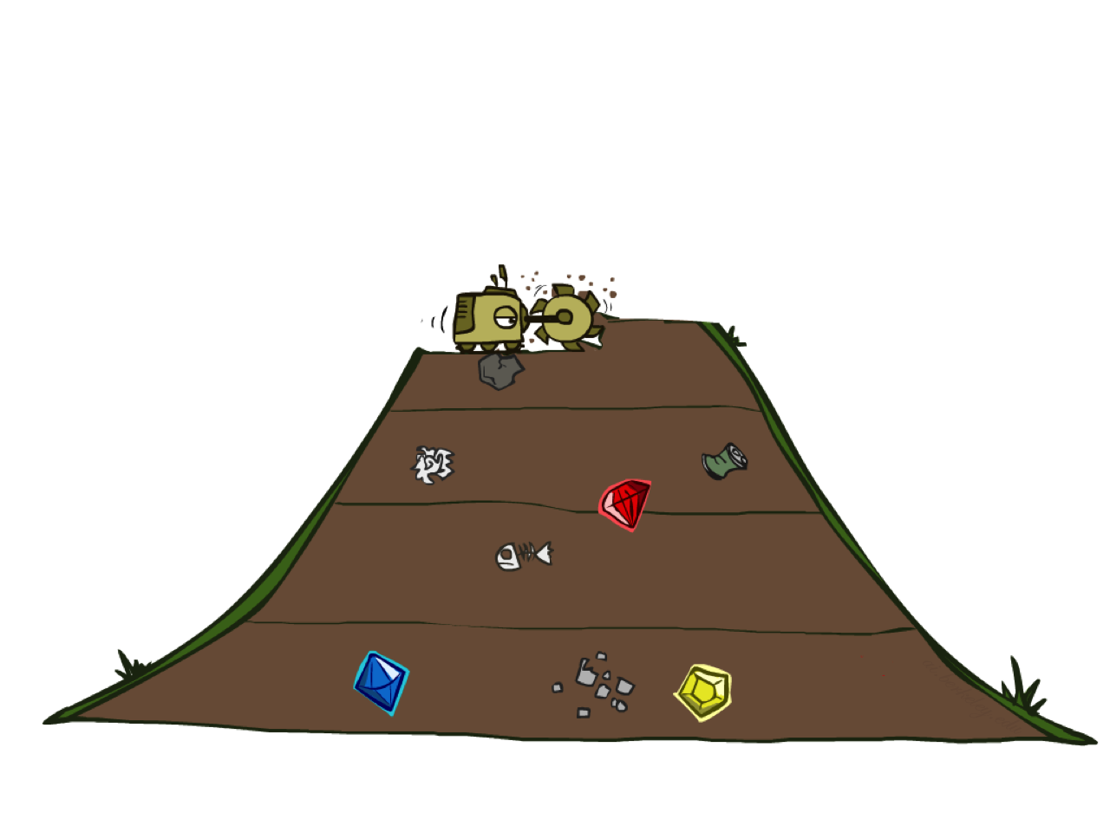
Breadth-First Search
Notes:
Го развива најплиткиот јазел, т.е оној јазел што е прв во листата неразложени јазли

Slide 38
Breadth-First Search
Strategy: expand a shallowest node first
Implementation: Fringe is a FIFO queue
a
G
b
c
d
e
f
S
h
p
q
r
S
d
e
p
Search
Tiers
b
c
e
h
r
q
a
a
h
r
p
q
f
p
q
f
q
c
G
q
c
G
a
a

Slide 39
Breadth-First Search (BFS) Properties
What nodes does BFS expand?
Processes all nodes above shallowest solution
Let depth of shallowest solution be s
Search takes time O(b^{s})
How much space does the fringe take?
Has roughly the last tier, so O(b^{s})
Is it complete?
s must be finite if a solution exists, so yes!
Is it optimal?
Only if costs are all 1 (more on costs later)
1 node
b
…
b nodes
s tiers
b² nodes
b^{s} nodes
b^{m} nodes
Notes:
Ако лаците имаат цена, тогаш не го наоѓа оптималното решение, но ако се претпостави дека цената на чекорите е еднаква, тогаш решението е оптимално.

Slide 40
Quiz: DFS vs BFS

Slide 41

Video of Demo Maze Water DFS/BFS (part 1)
Notes:
BFS

Slide 42
Video of Demo Maze Water DFS/BFS (part 2)
Notes:
DFS

Slide 43
Quiz: DFS vs BFS
When will BFS outperform DFS?
When will DFS outperform BFS?
Notes:
If the goal is shallow – ako celta e nekade blisko vo prvite sloevi do start BFS ke bide pooptimalna,
Koga imame celta (duri I poveke I site se) dlaboko vo drvoto DFS e podobro
Ako nemate memorija DFS e podobra opcija
BFS brzo ako e plitko, DFS podobro e za memorija

Slide 44
Iterative Deepening
Idea: get DFS’s space advantage with BFS’s time / shallow-solution advantages
Run a DFS with depth limit 1. If no solution…
Run a DFS with depth limit 2. If no solution…
Run a DFS with depth limit 3. …..
Isn’t that wastefully redundant?
Generally most work happens in the lowest level searched, so not so bad!
b
…
Notes:
BFS brzo ako e plitko, DFS podobro e za memorija

Slide 45
Cost-Sensitive Search
a
GOAL
2
2
b
c
3
2
1
8
2
e
d
f
3
9
8
2
START
h
1
4
2
p
4
r
15
q
BFS finds the shortest path in terms of number of actions.
It does not find the least-cost path. We will now cover
a similar algorithm which does find the least-cost path.

Slide 46

Uniform Cost Search
Notes:
Го развива „најефтиниот“ неразложен јазел
Новоразложените јазли се додаваат на крајот, а цената на сите поминати јазли се сумира

Slide 47
Uniform Cost Search
2
G
a
Strategy: expand a cheapest node first:
Fringe is a priority queue (priority: cumulative cost)
b
c
1
8
2
2
e
3
d
f
9
8
2
S
h
1
1
p
q
r
15
0
S
d
3
e
9
p
1
b
4
e
5
h
17
r
11
q
16
c
11
Cost contours
a
6
a
h
13
r
7
p
q
f
p
q
f
8
q
c
G
q
c
a
11
G
10
a

Slide 48
Uniform Cost Search (UCS) Properties
What nodes does UCS expand?
Processes all nodes with cost less than cheapest solution!
If that solution costs C* and arcs cost at least ε , then the “effective depth” is roughly C*/ε
Takes time O(b^{C*/ε}) (exponential in effective depth)
How much space does the fringe take?
Has roughly the last tier, so O(b^{C*/ε})
Is it complete?
Assuming best solution has a finite cost and minimum arc cost is positive, yes!
Is it optimal?
Yes! (Proof next lecture via A*)
b
c ≤ 1
…
C*/ε “tiers”
c ≤ 2
c ≤ 3
Notes:
Seto ona sto e vo memorija ima pogolema cena sleduva optimalno
Го развива „најефтиниот“ неразложен јазел
Новоразложените јазли се додаваат на крајот, а цената на сите поминати јазли се сумира

Slide 49
Uniform Cost Issues
Remember: UCS explores increasing cost contours
The good: UCS is complete and optimal!
The bad:
Explores options in every “direction”
No information about goal location
We’ll fix that soon!
…
c ≤ 1
c ≤ 2
c ≤ 3
Start
Goal
[Demo: empty grid UCS (L2D5)]
[Demo: maze with deep/shallow water DFS/BFS/UCS (L2D7)]
Notes:
Odi nasekade bez da misli kade moze da bide celta

Slide 50
Video of Demo Empty UCS
Notes:
Kaj BFS ke gi ignorira cenite, plitka I dlaboka voda

Slide 51
Video of Demo Maze with Deep/Shallow Water --- DFS, BFS, or UCS? (part 1)
Notes:
Let students guess which one of the three it is. (This is BFS.)

Slide 52
Video of Demo Maze with Deep/Shallow Water --- DFS, BFS, or UCS? (part 2)
Notes:
Let students guess which one of the three it is. (This is UCS.)

Slide 53
Video of Demo Maze with Deep/Shallow Water --- DFS, BFS, or UCS? (part 3)
Notes:
Let students guess which one of the three it is. (This is DFS.)

Slide 54

The One Queue
All these search algorithms are the same except for fringe strategies
Conceptually, all fringes are priority queues (i.e. collections of nodes with attached priorities)
Practically, for DFS and BFS, you can avoid the log(n) overhead from an actual priority queue, by using stacks and queues
Can even code one implementation that takes a variable queuing object

Slide 55
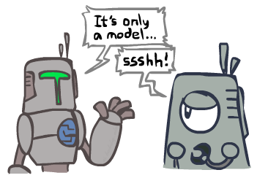
Search and Models
Search operates over models of the world
The agent doesn’t actually try all the plans out in the real world!
Planning is all “in simulation”
Your search is only as good as your models…

Slide 56
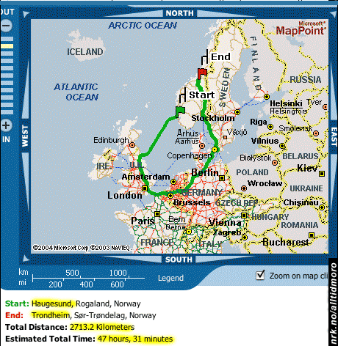
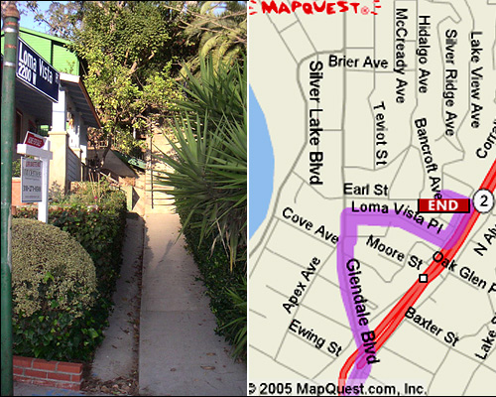

Search Gone Wrong?

Slide 57
Recap: Search

Slide 58
Recap: Search
Search problem:
States (configurations of the world)
Actions and costs
Successor function (world dynamics)
Start state and goal test
Search tree:
Nodes: represent plans for reaching states
Plans have costs (sum of action costs)
Search algorithm:
Systematically builds a search tree
Chooses an ordering of the fringe (unexplored nodes)
Optimal: finds least-cost plans

Slide 59
Example: Pancake Problem
Cost: Number of pancakes flipped
Notes:
Gates, W. and Papadimitriou, C., "Bounds for Sorting by Prefix Reversal.", Discrete Mathematics. 27, 47-57, 1979.

Slide 60
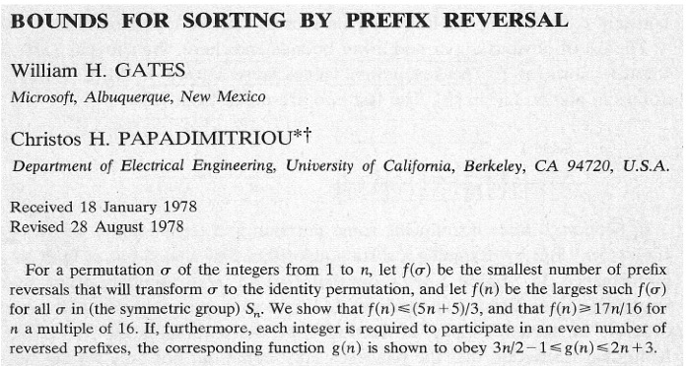
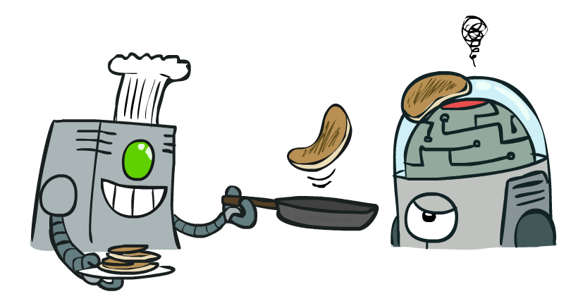
Example: Pancake Problem
Notes:
Gates, W. and Papadimitriou, C., "Bounds for Sorting by Prefix Reversal.", Discrete Mathematics. 27, 47-57, 1979.

Slide 61
Example: Pancake Problem
State space graph with costs as weights
4
2
3
2
3
4
3
4
2
3
2
2
4
3
Notes:
Ima vkupno 24 sostojbi
A* expanded 8100 ; Path cost = 33
UCS expanded 25263 . Path cost = 33
Greedy expanded 10 . Path cost = 41
[0, 7, 5, 3, 2, 1, 4, 6]
(7, 0, 5, 3, 2, 1, 4, 6)
(6, 4, 1, 2, 3, 5, 0, 7)
(3, 2, 1, 4, 6, 5, 0, 7)
(1, 2, 3, 4, 6, 5, 0, 7)
(5, 6, 4, 3, 2, 1, 0, 7)
(6, 5, 4, 3, 2, 1, 0, 7)
(0, 1, 2, 3, 4, 5, 6, 7)

Slide 62
General Tree Search
Action: flip top two Cost: 2
Action: flip all four Cost: 4
Path to reach goal:
Flip four, flip three
Total cost: 7
Notes:
You know exactly where you came from and how you got there, but you have no idea where you’re going. But, you’ll know it when you see it.

Slide 63
The One Queue
All these search algorithms are the same except for fringe strategies
Conceptually, all fringes are priority queues (i.e. collections of nodes with attached priorities)
Practically, for DFS and BFS, you can avoid the log(n) overhead from an actual priority queue, by using stacks and queues
Can even code one implementation that takes a variable queuing object
Notes:
DFS stack LIFO
BFS queue FIFO

Slide 64

Uninformed Search

Slide 65
Uniform Cost Search
Strategy: expand lowest path cost
The good: UCS is complete and optimal!
The bad:
Explores options in every “direction”
No information about goal location
c ≤ 1
…
c ≤ 2
c ≤ 3
Start
Goal

Slide 66
Video of Demo Contours UCS Empty

Slide 67
Video of Demo Contours UCS Pacman Small Maze
Notes:
Bright red porano e razloezn, temono crveno podocna – skoro site sostojbi se razlozeni
Zosto – ne znae kade e celta?
Poefikazni – dopolnitelno znaenje kolku blisku sme do celta

Slide 68

Informed Search

Slide 69
Some Hints for P1
Graph search is almost always better than tree search (when not?)
Implement your closed list as a dict or set!
Nodes are conceptually paths, but better to represent with a state, cost, last action, and reference to the parent node

